Slide 1
QUESTIONAIRE Hobbies
Daniela Holešová, Sára Grochalová I.H

Slide 2
How much time do you have after school?
Half of the people have 6 hours for doing their hobbies after school.

Slide 3
What do you like the most?
40% of the people like reading books in their free time.

Slide 4
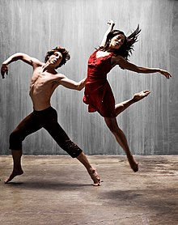
Favorite hobby
Most of the people said their favorite hobby is dancing and reading books.

Slide 5
Dancing
A lot of people do not dance, but some of them dance ballet or freestyle.

Slide 6
Extra curricular activities
Almost everyone love their extra curricular activities.

Slide 7
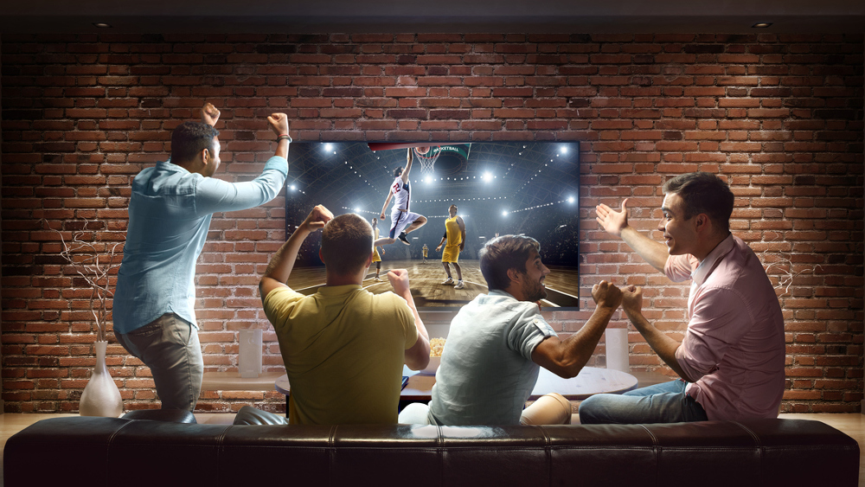
What do you rather do?
40%+ rather watch sports than do it.

Slide 8
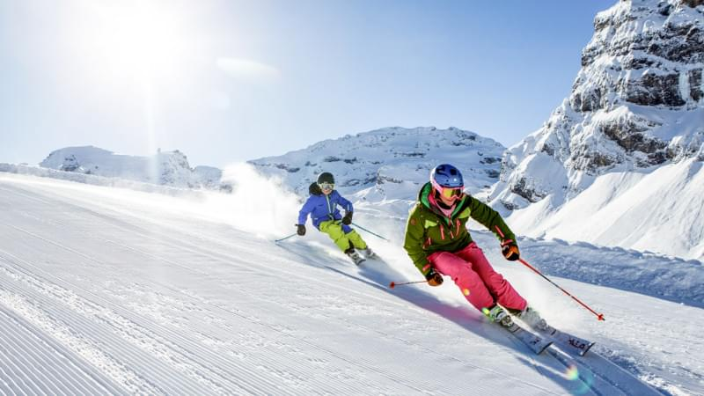
What do you prefer?
Half of the people prefer skiing.

Slide 9
How many days a week do you do your hobbies?
33% of the people do they hobbies once a week.

Slide 10
What kind of music do you like?
Most of the people like pop music and hip hop music.

Slide 11
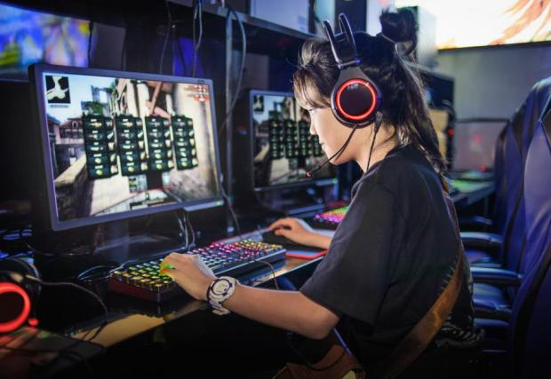
Favorite computer game
Most of the people don´t play computer games or they don´t have favorite one.

Slide 12
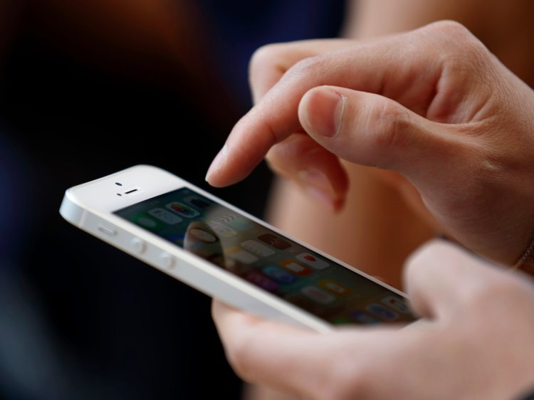
How many hours do you spend on a mobile per day?
A lot of people spend 3-4 hours on a mobile per day.

Slide 13
Thanks for attention

