Slide 1
My home town Žilina

Slide 2
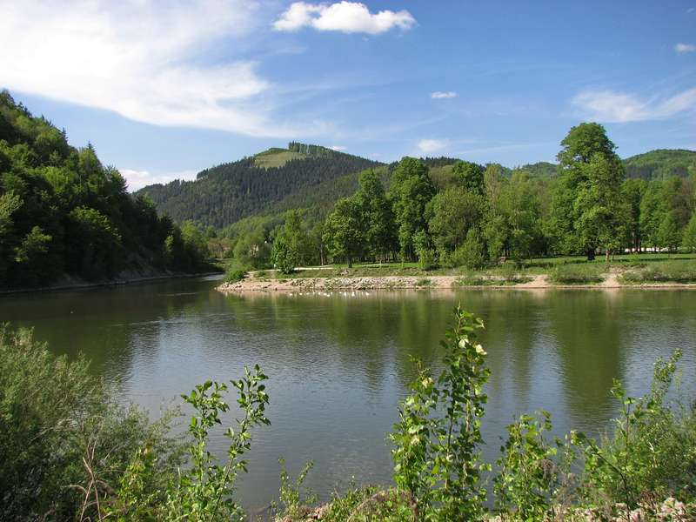
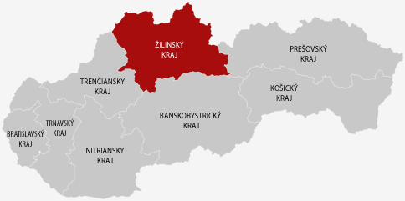
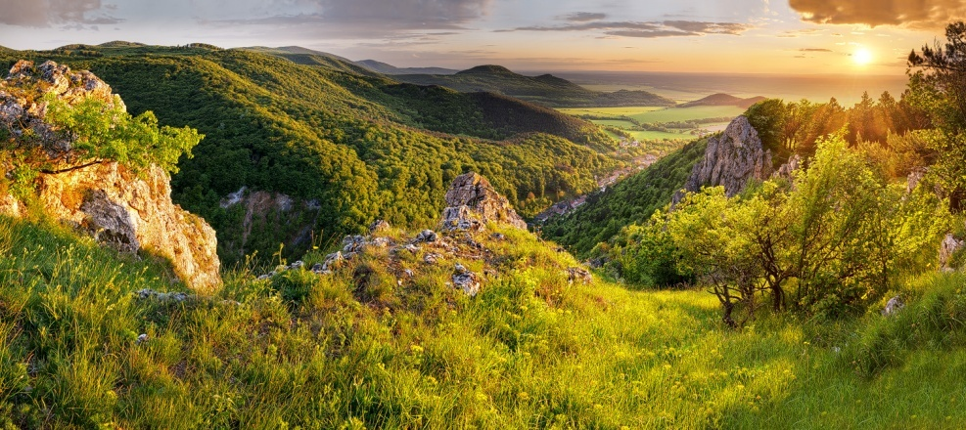
Žilina
in the north of Slovakia
3 rivers: Váh, Kysuca, Rajčianka
the fourth largest city in Slovakia
pearl of river Váh
20 urban areas e.g.:Bánová, Solinky, Hliny, Hájik, Brodno,...

Slide 3
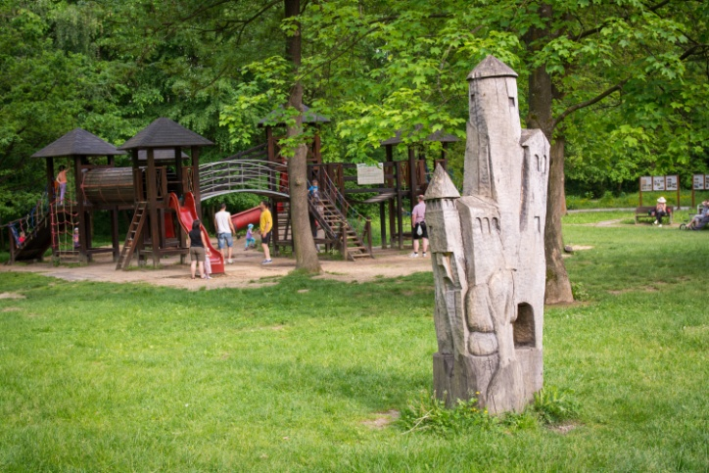
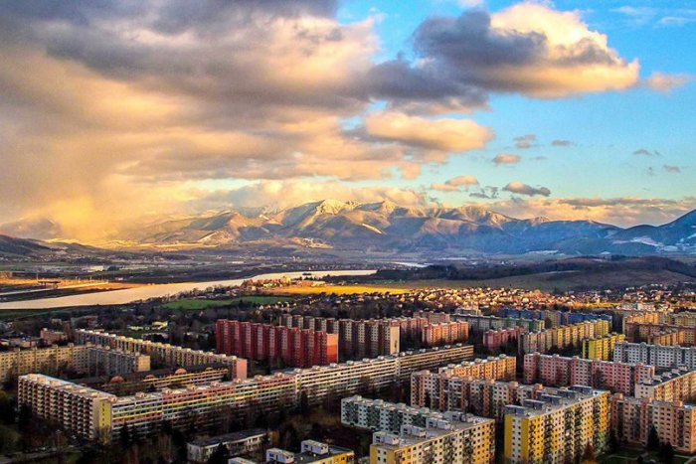
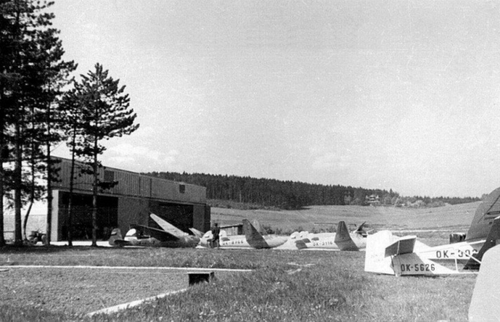
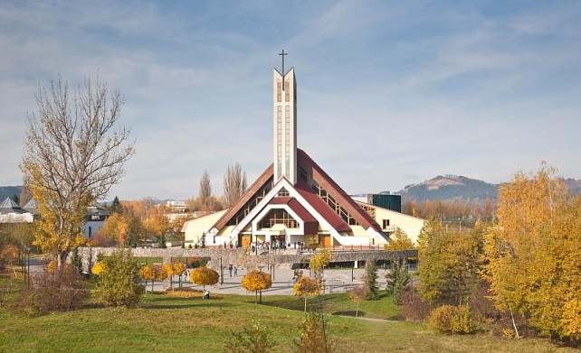
Vlčince
the biggest settlement in Žilina
began to build in 1971 according to design by architect Emil Galovský
there are 7500 flats with 20 077 people
there was an airport in the thirties
There is the Lespark chrasť: it is a forest with playground and rope park Preles
Vlčince are diveded for 4 parts: Vlčince I- Vlčince IV
postal code is 010 08

Slide 4
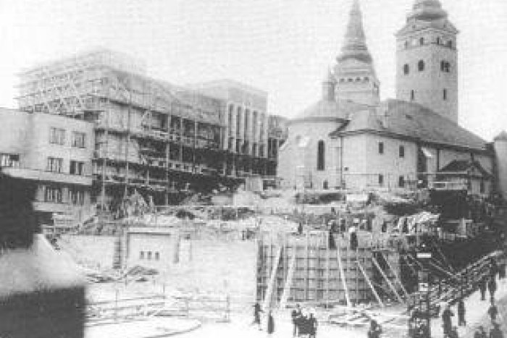
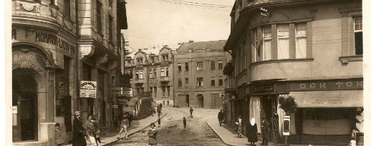
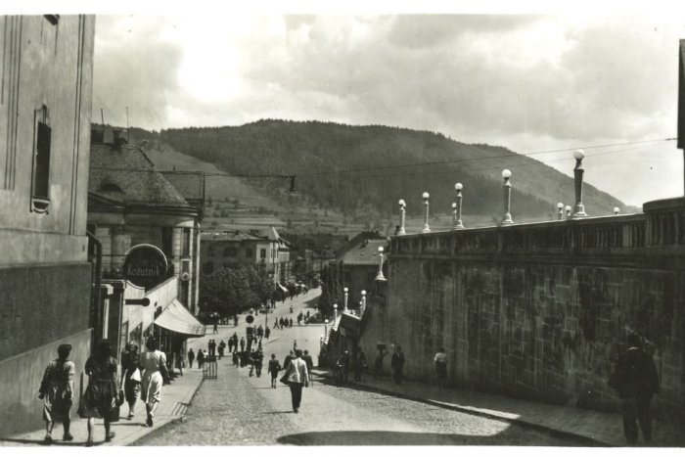
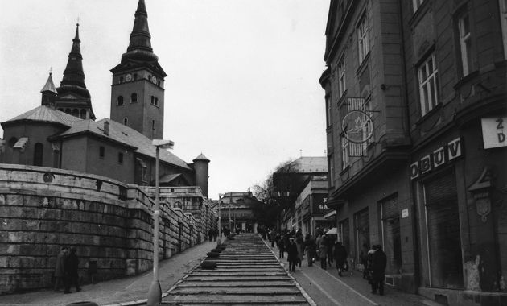
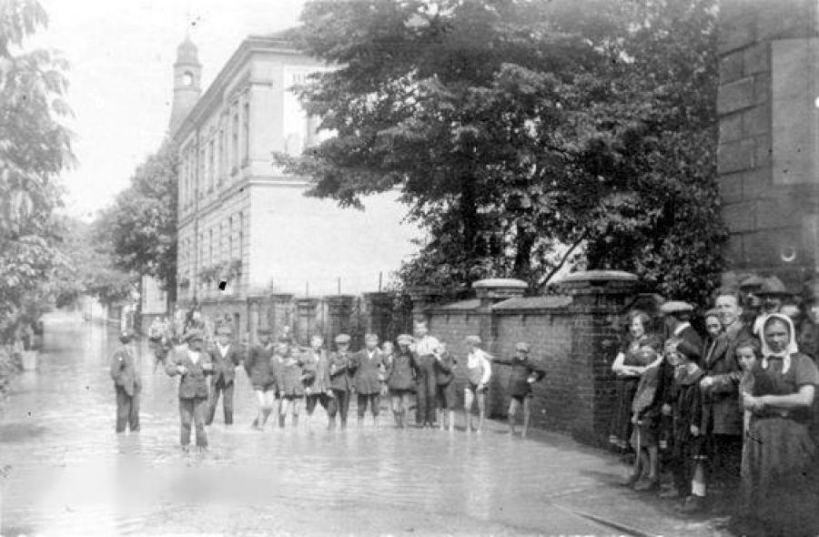
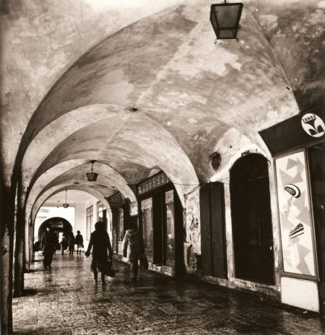
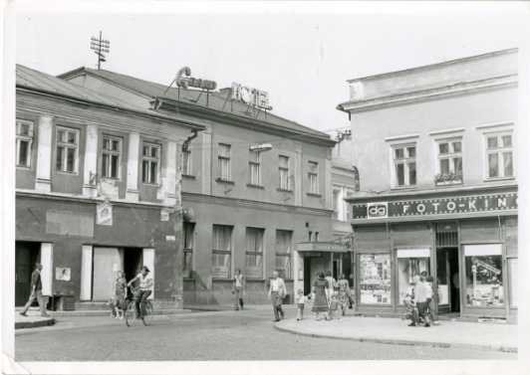
100 years ago

Slide 5
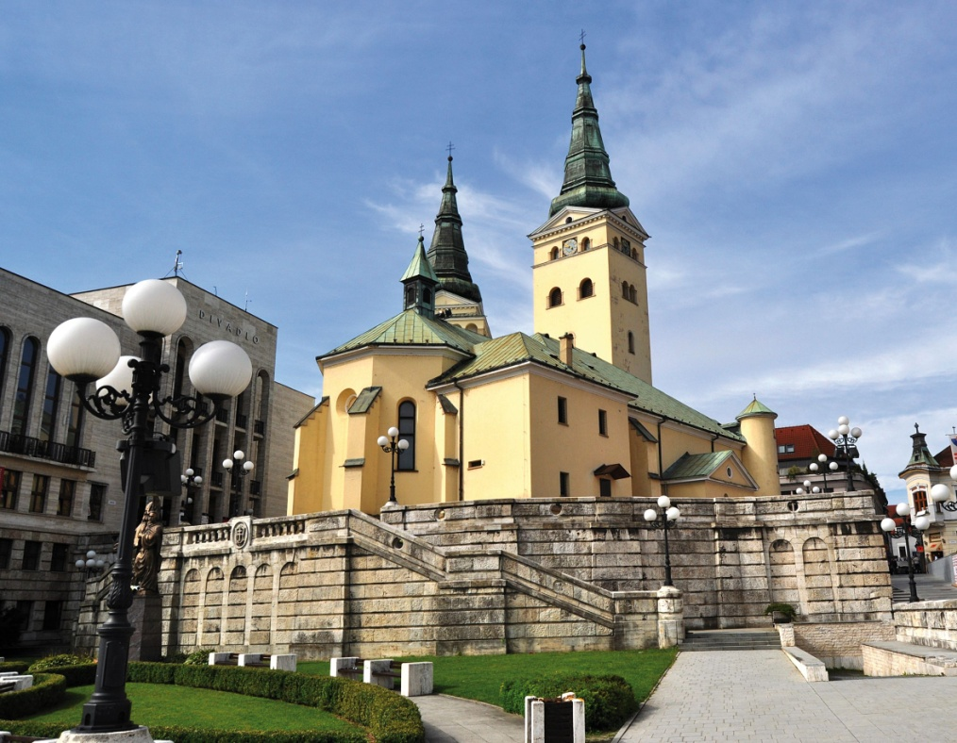
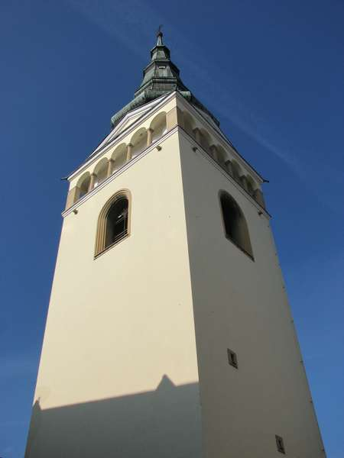
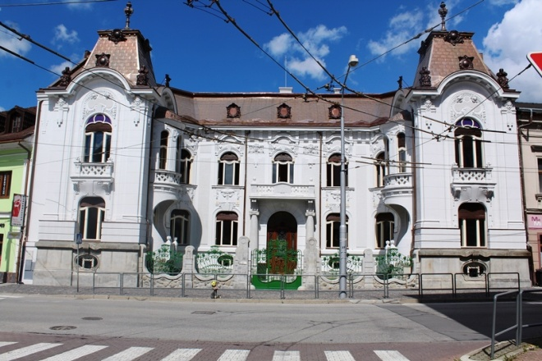
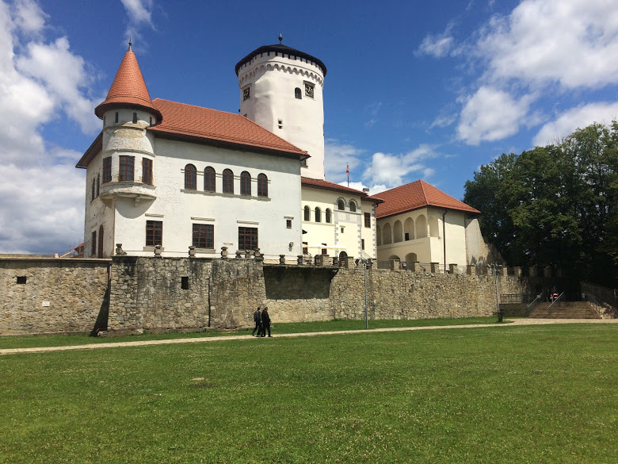
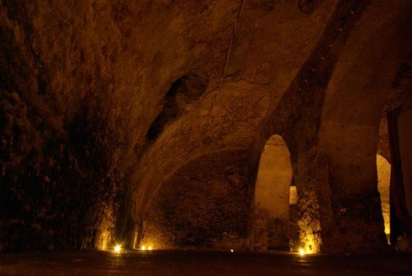
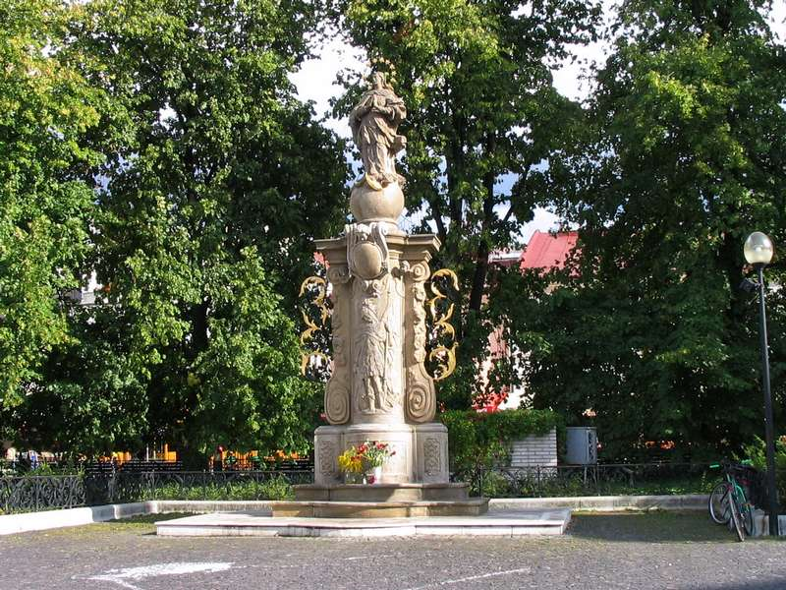
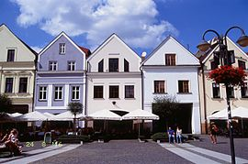
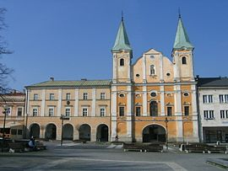
Monuments

Slide 6
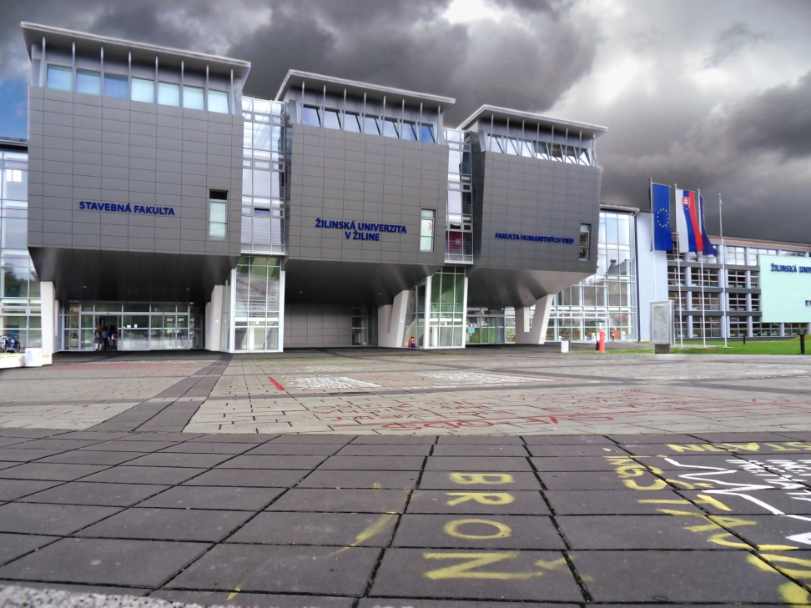
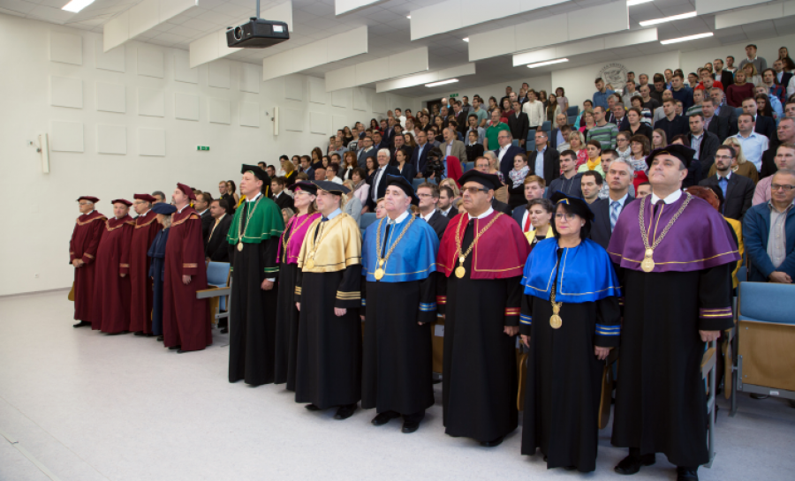
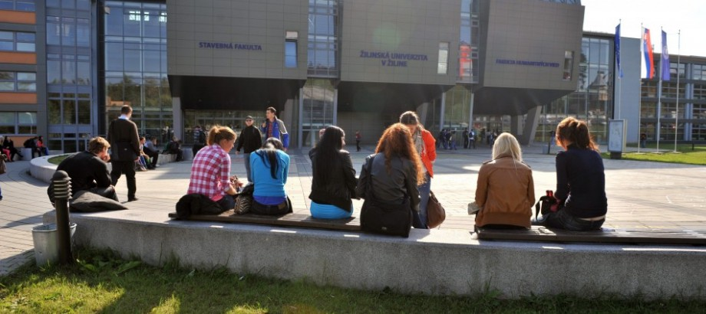
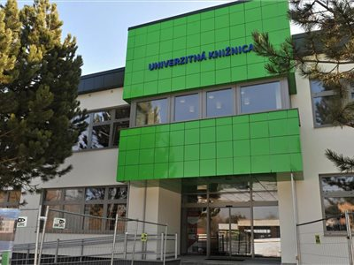
University of Žilina

Slide 7
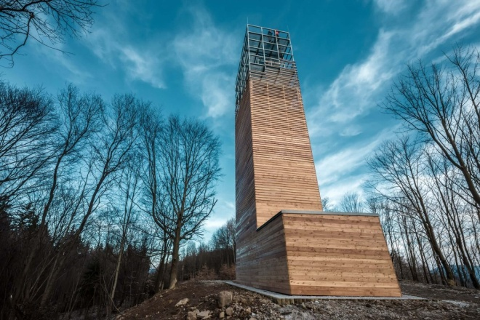
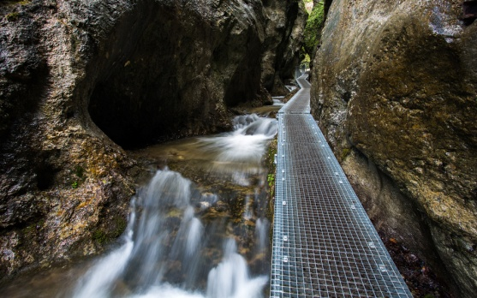
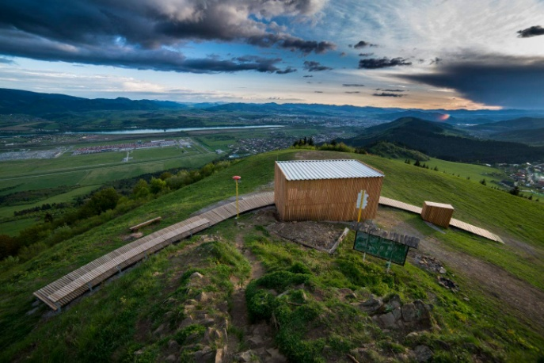
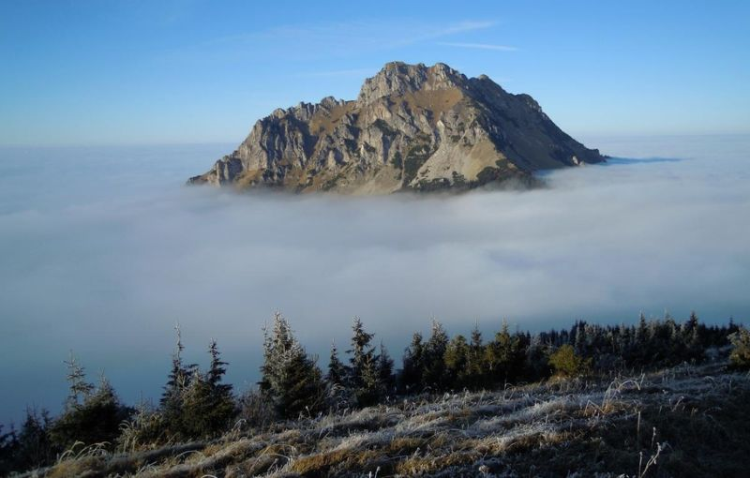
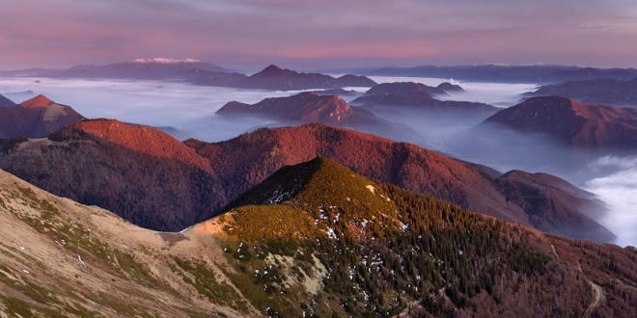
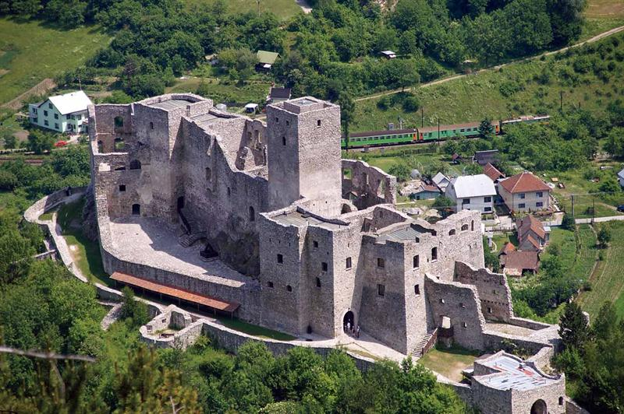
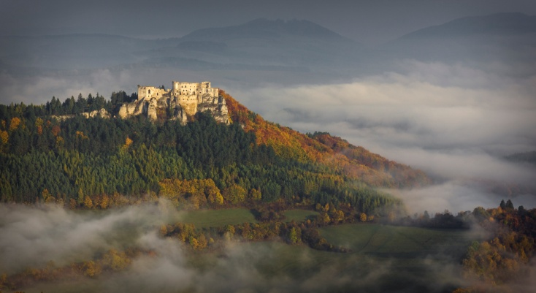
Nature and tourism

Slide 8
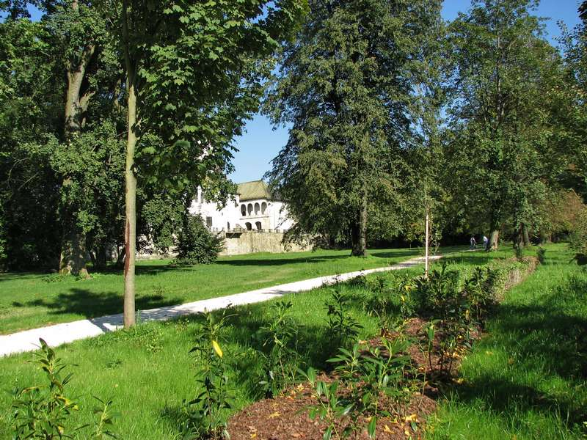
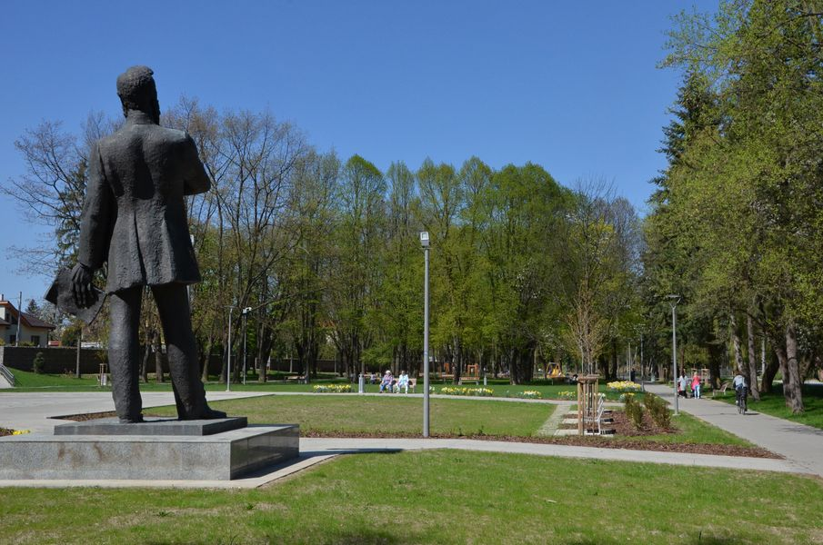
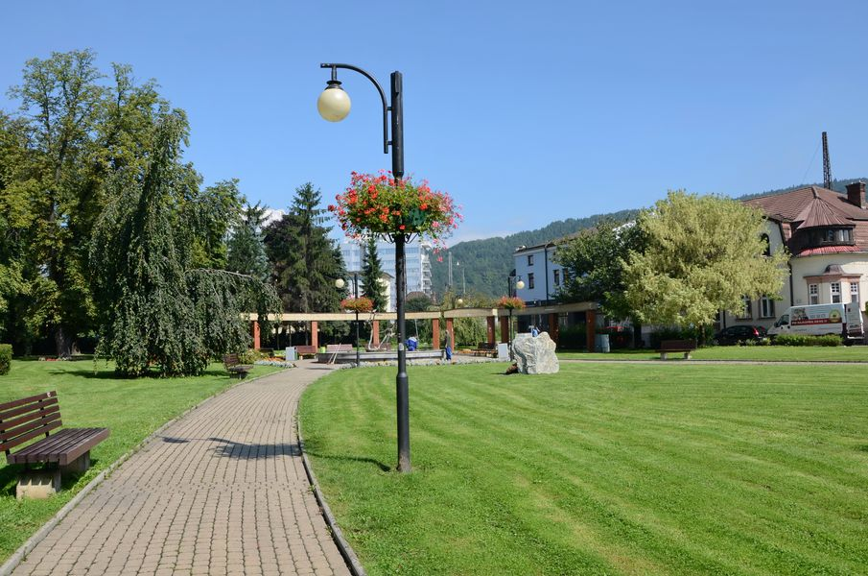
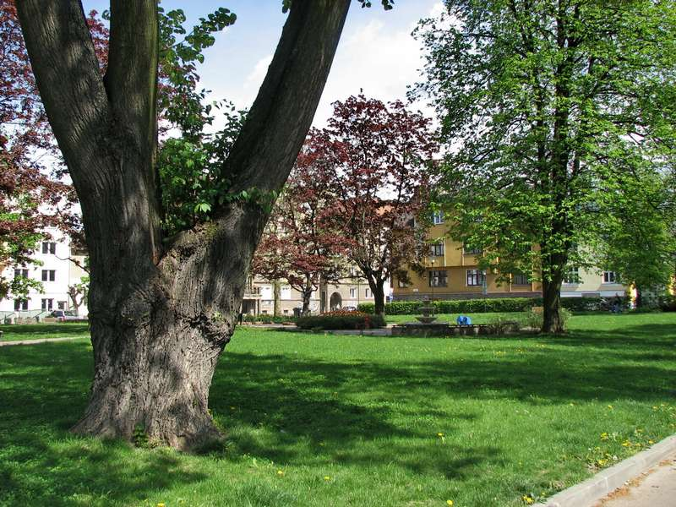
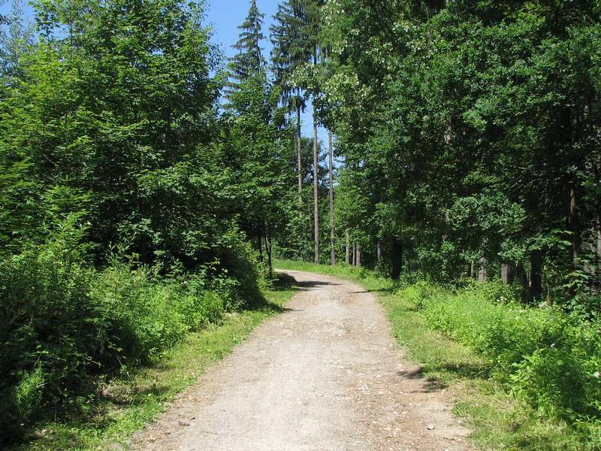
Parks

Slide 9
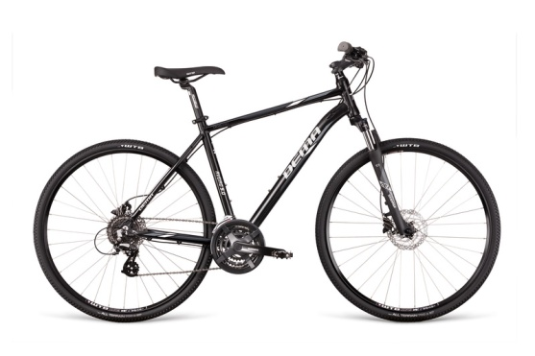
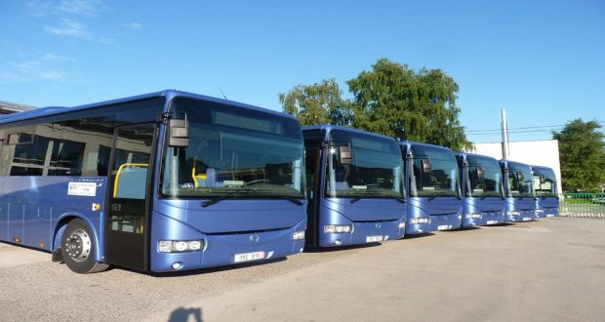
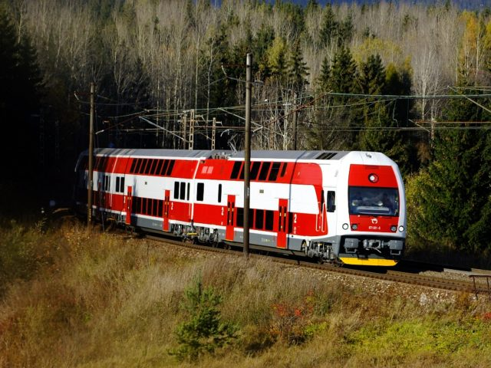
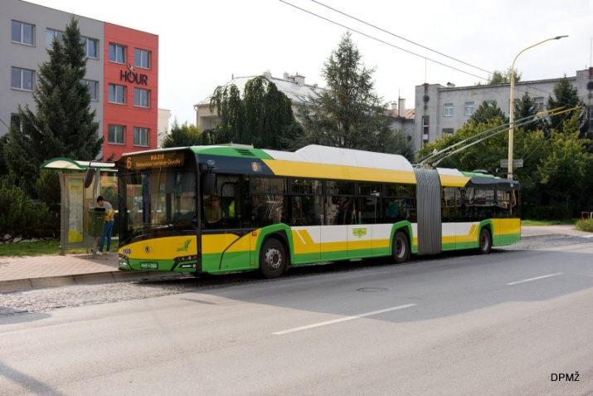
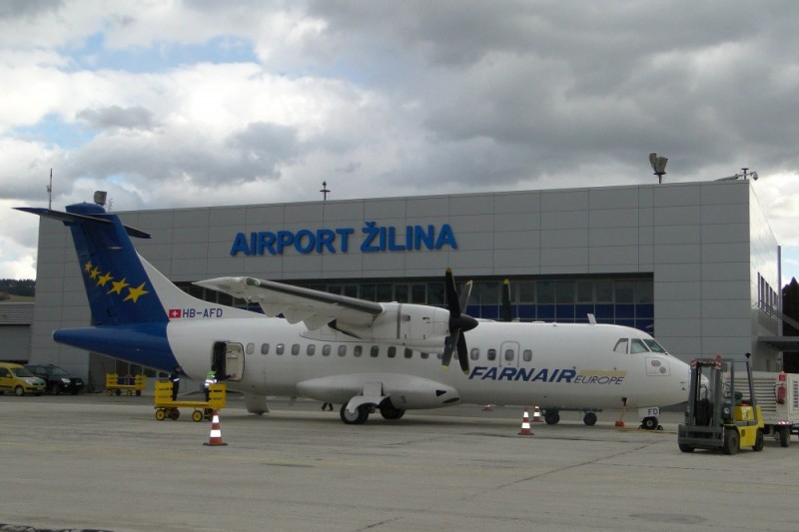
Transportation

Slide 10
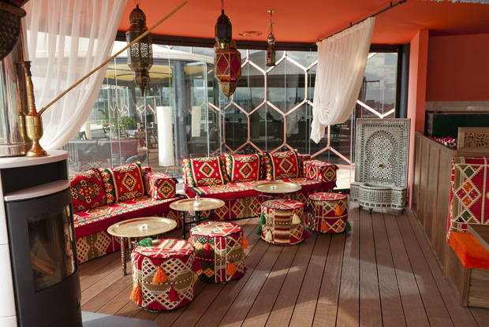
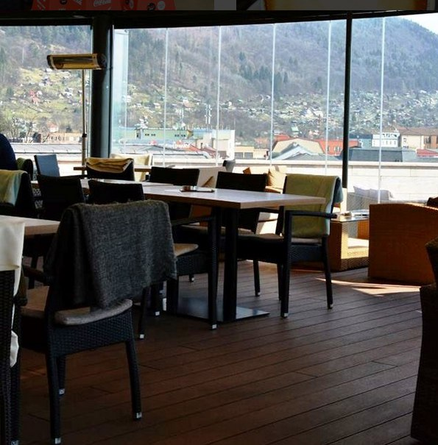
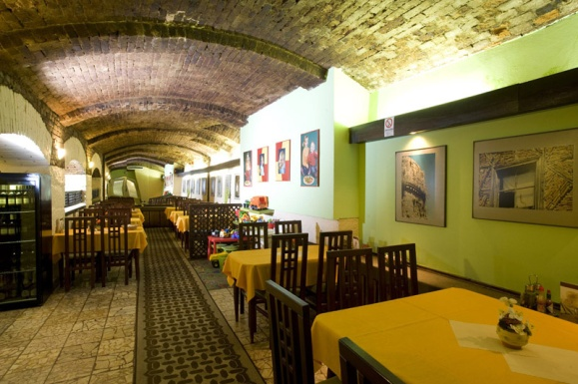
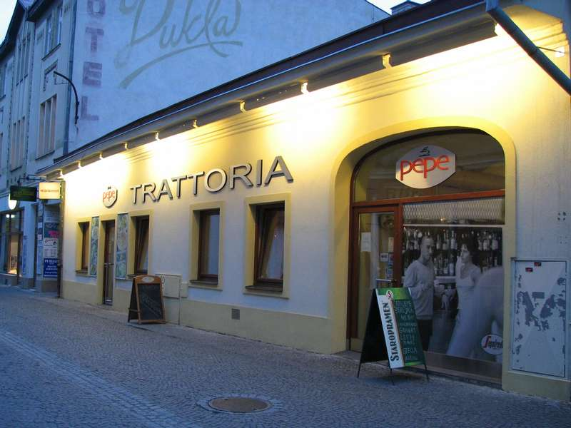
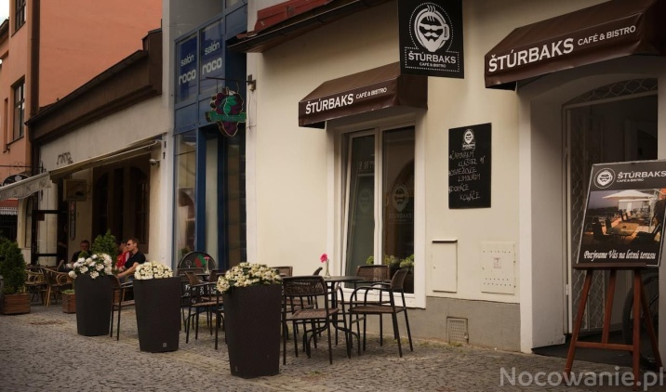
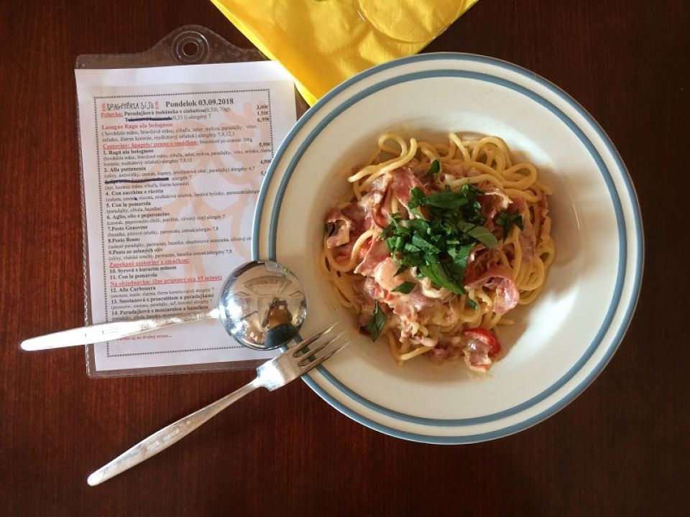
Restaurants and bars

Slide 11
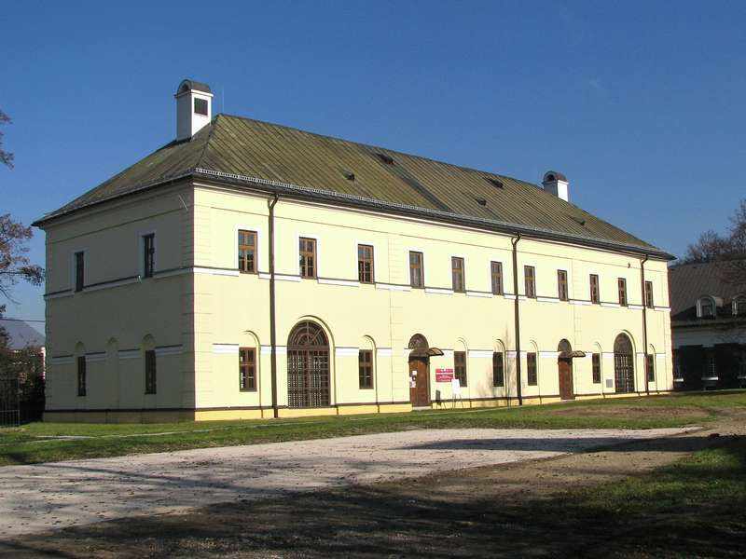
Theaters, museums and gallery

Slide 12
Sports

Slide 13
Important personalities

Slide 14
Rescources
http://zilina-gallery.sk/index.php?/category/24
http://zilina-gallery.sk/index.php?/category/6
https://www.google.com/search?q=historicka+zilina&client=firefox-b&source=lnms&tbm=isch&sa=X&ved=0ahUKEwjr0PnC_ZfeAhUQWBoKHZoTCiYQ_AUIDigB&biw=1920&bih=916#imgrc=MY24ZnOGCevyhM:
https://sk.wikipedia.org/wiki/%C5%BDilina
http://www.zilina.sk/?page=uvod
https://sk.wikipedia.org/wiki/Vl%C4%8Dince
https://www.tripadvisor.sk/Attractions-g274946-Activities-c47-Zilina_Zilina_Region.html
https://www.uniza.sk/index.php
https://www.kamnavylet.sk/atrakcie/turistika/zilina
https://zilina.dnes24.sk/foto-z-najkrajsich-miest-top-5-turistickych-tras-v-blizkosti-ziliny-251938
https://www.sadza.sk/
http://www.dpmz.sk/
http://www.slovakrail.sk/
https://www.tripadvisor.sk/Restaurants-g274946-Zilina_Zilina_Region.html
http://zilina-gallery.sk/index.php?/category/24
http://www.mskzilina.sk/
https://sk.wikipedia.org/wiki/Kateg%C3%B3ria:Osobnosti_zo_%C5%BDiliny

Slide 15
Thank you for your attention!

